Slide 1
Promoting Student Engagement with University Study
Professor Glen Bates
PVC (Student Advancement)
Notes:
Save this template as a new PowerPoint Presentation, giving it the name you require OR copy these templates from Slide Master view into your existing presentation’s Slide Master options
If you go to >View > Slide Master you will see this template can be applied in Black, White or Grey background versions (which you will apply as you build or edit your presentation)
Close Slide Master view. You can now construct your presentation.
In the Slides area, select ‘New Slide’ to add a new slide.
To apply a slide style to the new/highlighted slide - in the Slides area, select ‘Layout’ menu, select preferred slide style from the menu (eg. ‘Title and Content’) , select ‘Reset’.
If you are updating an existing presentation, existing styles may not automatically update (hence using ‘reset’,) especially if the existing slide has not been produced with a template.
Text from imposed text boxes may need to be cut & pasted into new auto-generated template text boxes etc.
You should only use one colour template for each presentation (eg. Only black background, or white, or grey – not a combination)
The Design uses only 24pt Arial as the font, with 22pt the minimum text size (used at third level).
The title page ‘wave’ graphics can be increased in width, but not height.
1

Slide 2
Student Engagement
‘students are more likely to succeed . . . in settings that are committed to their success, hold high expectations for their success, provide needed academic and social support, give frequent feedback and actively involve them, especially with other students and faculty, in learning’. (Tinto, 2005, p. 94).
At Swinburne engaged learning is about providing a positive learning experience for each student to help them succeed and meet their learning objectives
Notes:
2

Slide 3
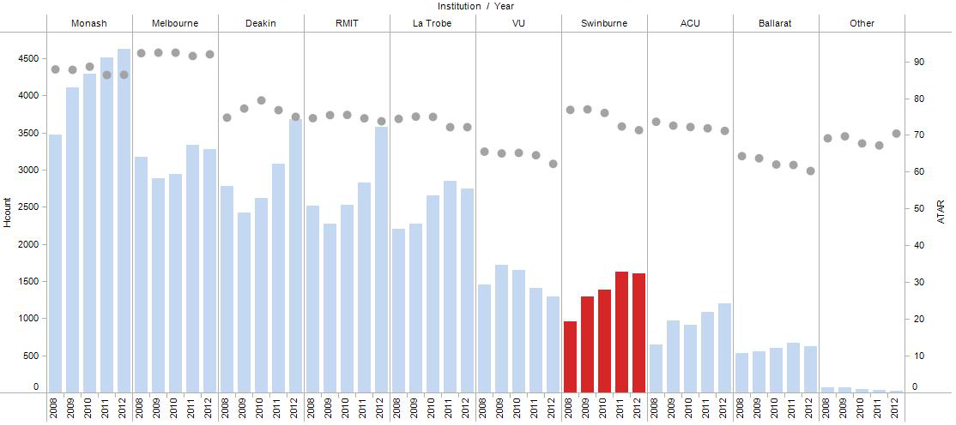
Commencing Headcount (via VTAC) and mean ATAR, Victorian universities, 2008 – 2012

Slide 4
Faculty of Life and Social Sciences Total EFTSL Enrolments, 2004-2012

Slide 5
Current Patterns of Attrition in Higher Education
At Swinburne our rate of attrition has risen from 14.1 to 15.1 overall and from 17.5 to 18.5 in LSS
Across the sector, around 50% of the total number of students who drop out of university courses do so in first year and most do so by mid way through Semester 1
The remaining 50% are spread over second and third year with second year the heaviest
Notes:
5

Slide 6
The Nature of Attrition
Non-arrivals
Healthy attrition
Course transfers
Correct life decisions
Unhealthy attrition
Disillusionment
Disconnection

Slide 7
Some Key Predictors of Vulnerability to Unhealthy Attrition
Lower ATARS or Entry via VET
Low family experience of university
Coming from rural areas or interstate
Lack of direction in course selection
Science vs Arts/Social Science
Finances
Lack of connection to university
Notes:
7

Slide 8
The Nature of Connectedness
Connectedness involves:
A sense of belonging
A sense of purpose
A sense of being in contact with fellow students
A sense of being in contact with staff

Slide 9
Increasing Connectedness
Mentor programs
Orientation and reorientation
U2university in VET
Study groups
Swinburne Connect and engagement staff
‘Boot camps’ and ‘Boot laces’ programs
VET entry
New year and Mid year entry
At Risk or show cause students

Slide 10
LSS Student Issues in 2013
New Ongoing At Risk
At risk situations 33% 25% 28%
Personal issues 25% 27% 46%
Course advice 40% 45% 22%
Other 2% 3% 4%
Notes:
10

Slide 11
Comparison of unit Results of help seeking At Risk/Show Cause Students (N = 139)
Semester 2, 2012
Fail/withdraw 60.6%
Deferred 0.0%
Pass 21.8%
Credit to HD 17.1%
Semester 1, 2013
Fail/withdraw 32.6%
Deferred 5.3%
Pass 34.0%
Credit to HD 28.1%

Slide 12
Some Directions
Improve links between Swinburne connect, faculties and student services
Raise student awareness of information about courses and course outcomes
Make access to support programs more uniform across faculties
Better understand what the constellation of factors is that enhamnces engagement at Swinburne
Notes:
12

Slide 13
Notes:
13
For an international presentation CRICOS code needs to be added – CRICOS 00111D
The final page ‘wave’ graphics can be increased in width, but not height.

