Slide 1
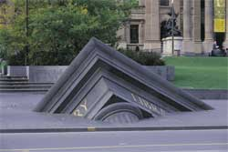
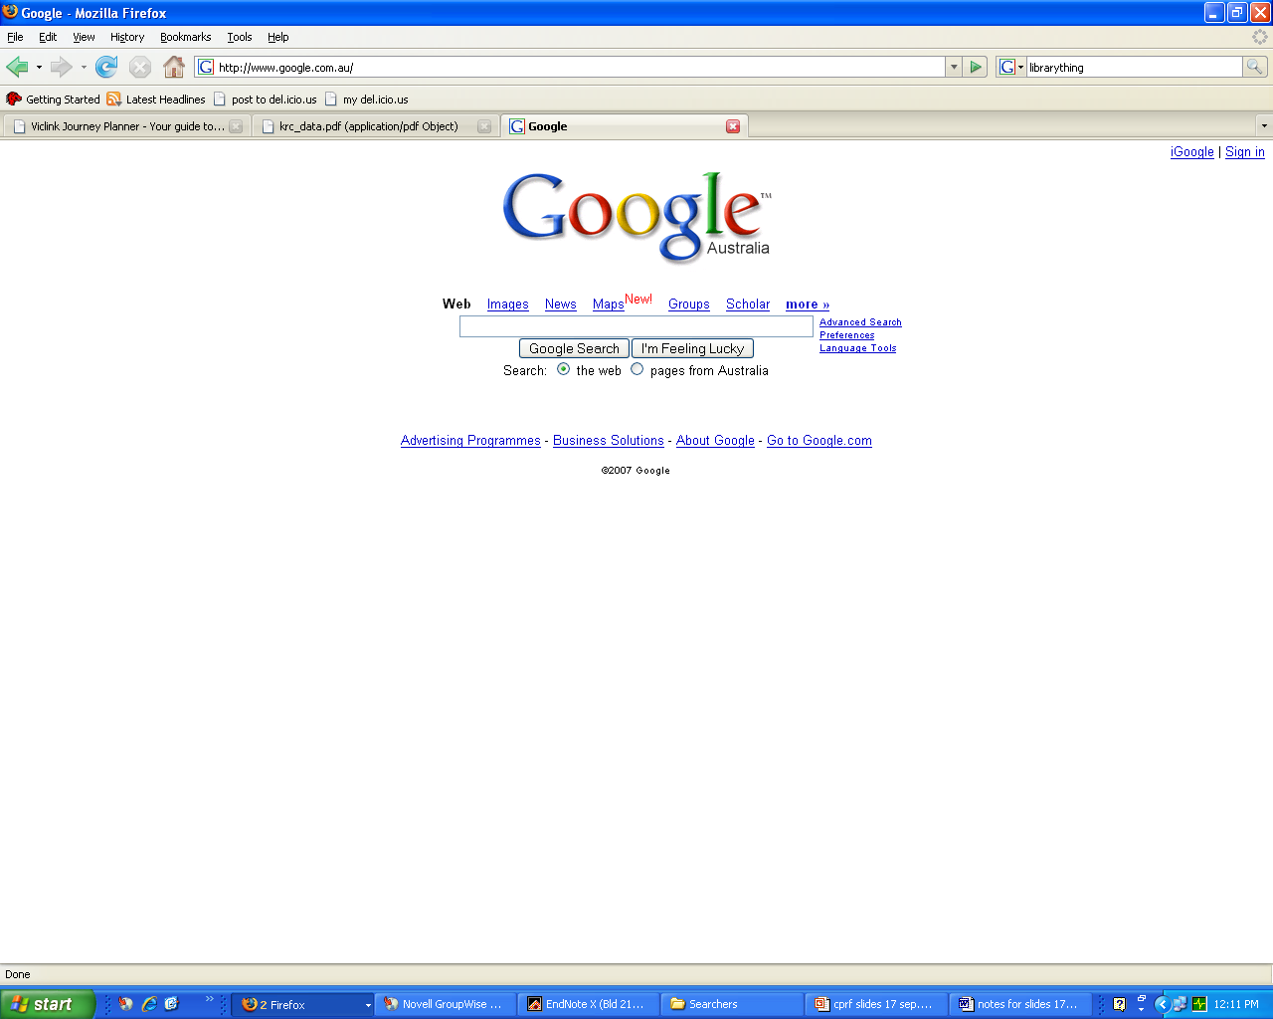
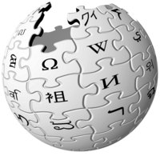
Searching on the Internet – or not
Dr Vivienne Waller
Notes:
1

Slide 2
“Information is the currency of democracy”
By 2011, it was estimated that 1.6 trillion Internet searches are conducted worldwide each year
Notes:
2

Slide 3
Finding information on the Internet
73% of surveyed Australian Internet users described the Internet as an ‘important’ or ‘very important’ source of information (Ewing, Thomas et al. 2010)
64% of British Internet users mainly used search engines when they are looking for information online (Dutton, Helsper et al. 2009).
about 60% of all US Internet users use search engines on a typical day (PEW Internet project 2012)
In Australia, one in eight website visits in the 4 weeks ending April 2009 was to a search engine (Source: www.hitwise.com)
Notes:
3

Slide 4
The integrity of Google search results
‘We expect that advertising funded search engines will be inherently biased towards the advertisers and away from the needs of the consumers’
Sergey Brin and Larry Page,
Google co-founders (1998)

Slide 5
The integrity of Google search results
Personalised search - We may not be exposed to information that challenges our world view
Semantic search – a particular world view underlies the search result – but this is not transparent to the user

Slide 6
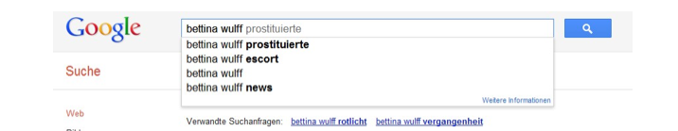
…and even before you get to the search results…

Slide 7
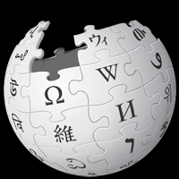
Wikipedia
As of October 2013, Wikipedia contained
more than 4.3 million articles in English
More than 100,000 articles in each of 45 languages.
(Source: www.wikipedia.org accessed 3 October 2013)
In Australia, in April 2009, Wikipedia was the twelfth most visited site on the Internet
(Source: Hitwise Australia, www.hitwise.com)
7

Slide 8
Research on current information-seeking
The Searchers: 3 year ARC linkage project
Institute for Social Research, Swinburne University
State Library of Victoria
Chief Investigators: Julian Thomas
Denise Meredyth
Research Fellows: Vivienne Waller
Ian McShane

Slide 9
Empirical examination of the subject of search queries – using transaction logs from Hitwise (basically a raw feed of two fifths of all Australian internet subscriptions)
Information on the lifestyle of the searcher was attached
Wikipedia
Google

Slide 10
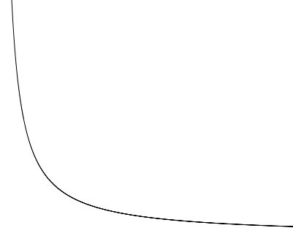
Including the long tail of search terms
%
Frequency of search term
20%
80%
Unique search terms
10
10

Slide 11
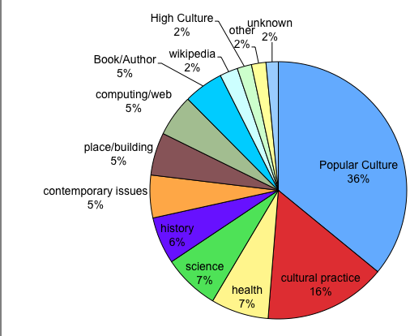
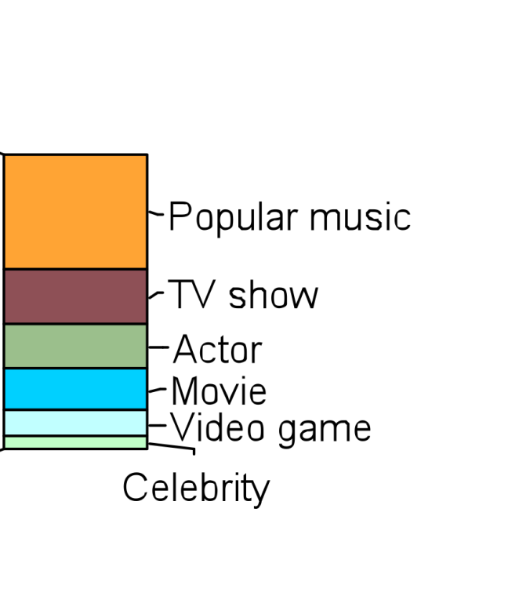
Search terms that took people to Wikipedia, April 2009
Leisure search
14%
7%
5%
5%
9%
Cultural practice - nec
5%
Sport
Religion (1%)
11

Slide 12
Search terms typed into Google (Australia), April 2009

Slide 13
Search terms typed into Google (Australia), April 2009
Informational queries
Weather/time/public transport (3%)
Contemporary
Issues (3%)
Other (2%)
Celebrity (3%)
History, Gen, High Culture, Science (4%)
Actor (3%)
Video Game (4%)
Place/building (4%)
Movie (4%)
Computing/Web (4%)
Popular Culture (29%)
Popular music (8%)
Health (6%)
Unknown (6%)
TV (8%)
ECommerce
(20%)
Cultural Practice
(19%)
Banking/finance (1%)
Religion, events, hobbies(2%)
Buying/selling (1%)
Travel/flight (2%)
Food (2%)
Service (3%)
Learning/job(3%)
Sport (6%)
Name of product (12%)
Cultural practice, nec (6%)

Slide 14
Comparing subjects across Wikipedia and Google

Slide 15
Approximate relative sizes of the number of queries using each information resource

Slide 16
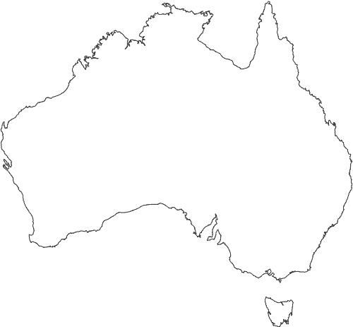
79% of Australians aged 15 or over have used the internet in the previous year (2010/11)
79% of households have an internet connection (ABS 2010-2011)
About 1 in 5 Australians
have not used the Internet in the previous year
Source: ABS 8146.0 - Household Use of Information Technology, Australia, 2010-11

Slide 17
In general, amongst Internet users in the study, there was scepticism expressed towards Wikipedia in contrast to a lack of critical engagement with Google search results

Slide 18
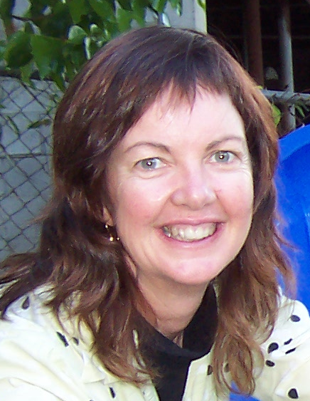
Nicole
Has home internet connection
Cannot use, does not want to use, does not need to use the Internet – she can ask her friends and children to look up things for her

Slide 19
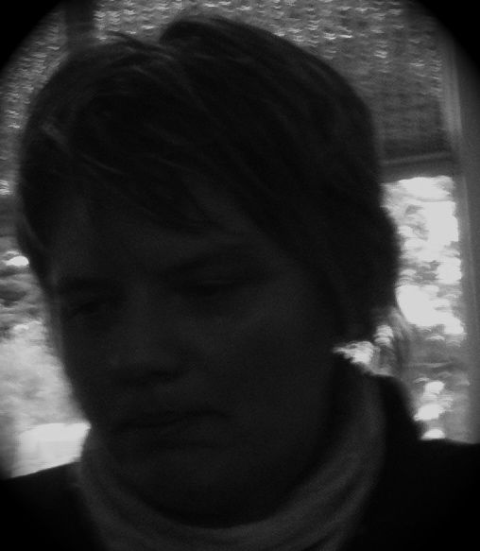
Jane
Policy-makers ‘imagined Internet user’ –
looks up court procedures on her
smartphone while commuting into the city
Notes:
www.flickr.com/photos/27139502@N00/351309426

Slide 20
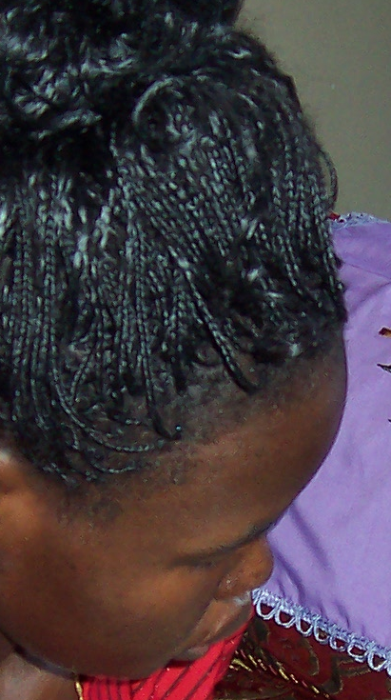
Amina
Amina’s interpreter explained “She knew back in Africa, that Red Cross assists people who have been separated in the war but she didn’t know whether Red Cross was here. So, she was told it’s in the city, and so she spent a few days going into the city and looking around until she found it at last.
Interviewer: just asking people?
Interpreter : she would catch the train to the city and then ask around, and someone would tell her, go to the next building or four blocks.
Interviewer: just ask people in the street?
Amina: yes

Slide 21
“Information is the currency of democracy” Thomas Jefferson,
By 2011, it was estimated that 1.6 trillion Internet searches are conducted worldwide each year

Slide 22
Relevant publications
    Waller, V (2013) “Diverse everyday information practices in Australian households” Library and Information Research 37(115): 58-79
    Waller, V (2011) "The search queries that took Australian Internet users to Wikipedia" Information Research 16(2) paper 476.
Waller, V. (2011) “Not Just Information: Who Searches for What on the Search Engine Google?” Journal of the American Society for Information Science and Technology, 62(4):761–775
    Waller, V (2011). “Searching where for what: A comparison of use of the library catalogue, Google and Wikipedia” Library and Information Research 35(110)
Waller, V. (2010) “Accessing the collection of a large public library: an analysis of OPAC use” LIBRES [Online] 20 (1) March 2010
Waller, V. (2009) What do the public search for on the catalogue of the State Library of Victoria? Australian academic and research libraries 40(4):266-285
Waller, V (2009) "The relationship between public libraries and Google: Too much information" First Monday [Online], 14 (9) (22 August 2009)
Waller, V (2009) “How do virtual visitors get to the library” The Electronic Library, 27(5): 815-830

